Slide 1
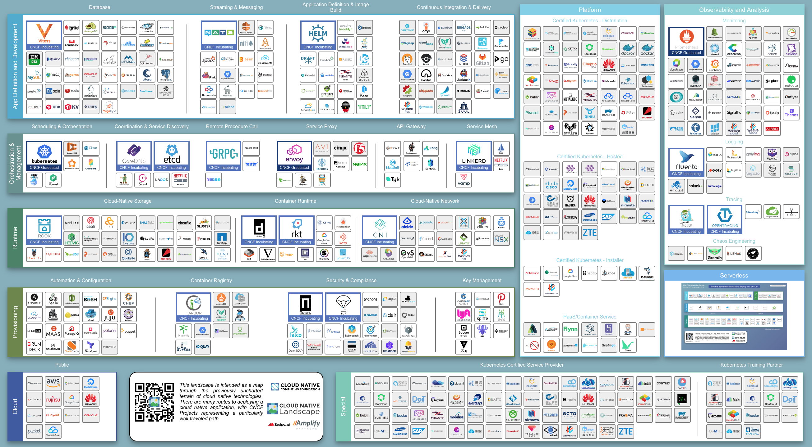

Slide 2

Workshop : The road to Kubernetes
DevOps - Continuous Delivery
Infrastructure as Code (IaC)
Azure - AKS - Git - Docker
Continuous Integration
Kubernetes – Helm – Istio Terraform
Houssem Dellai
Microsoft MVP
youtube.com/houssemdellai
@HoussemDellai

Slide 4
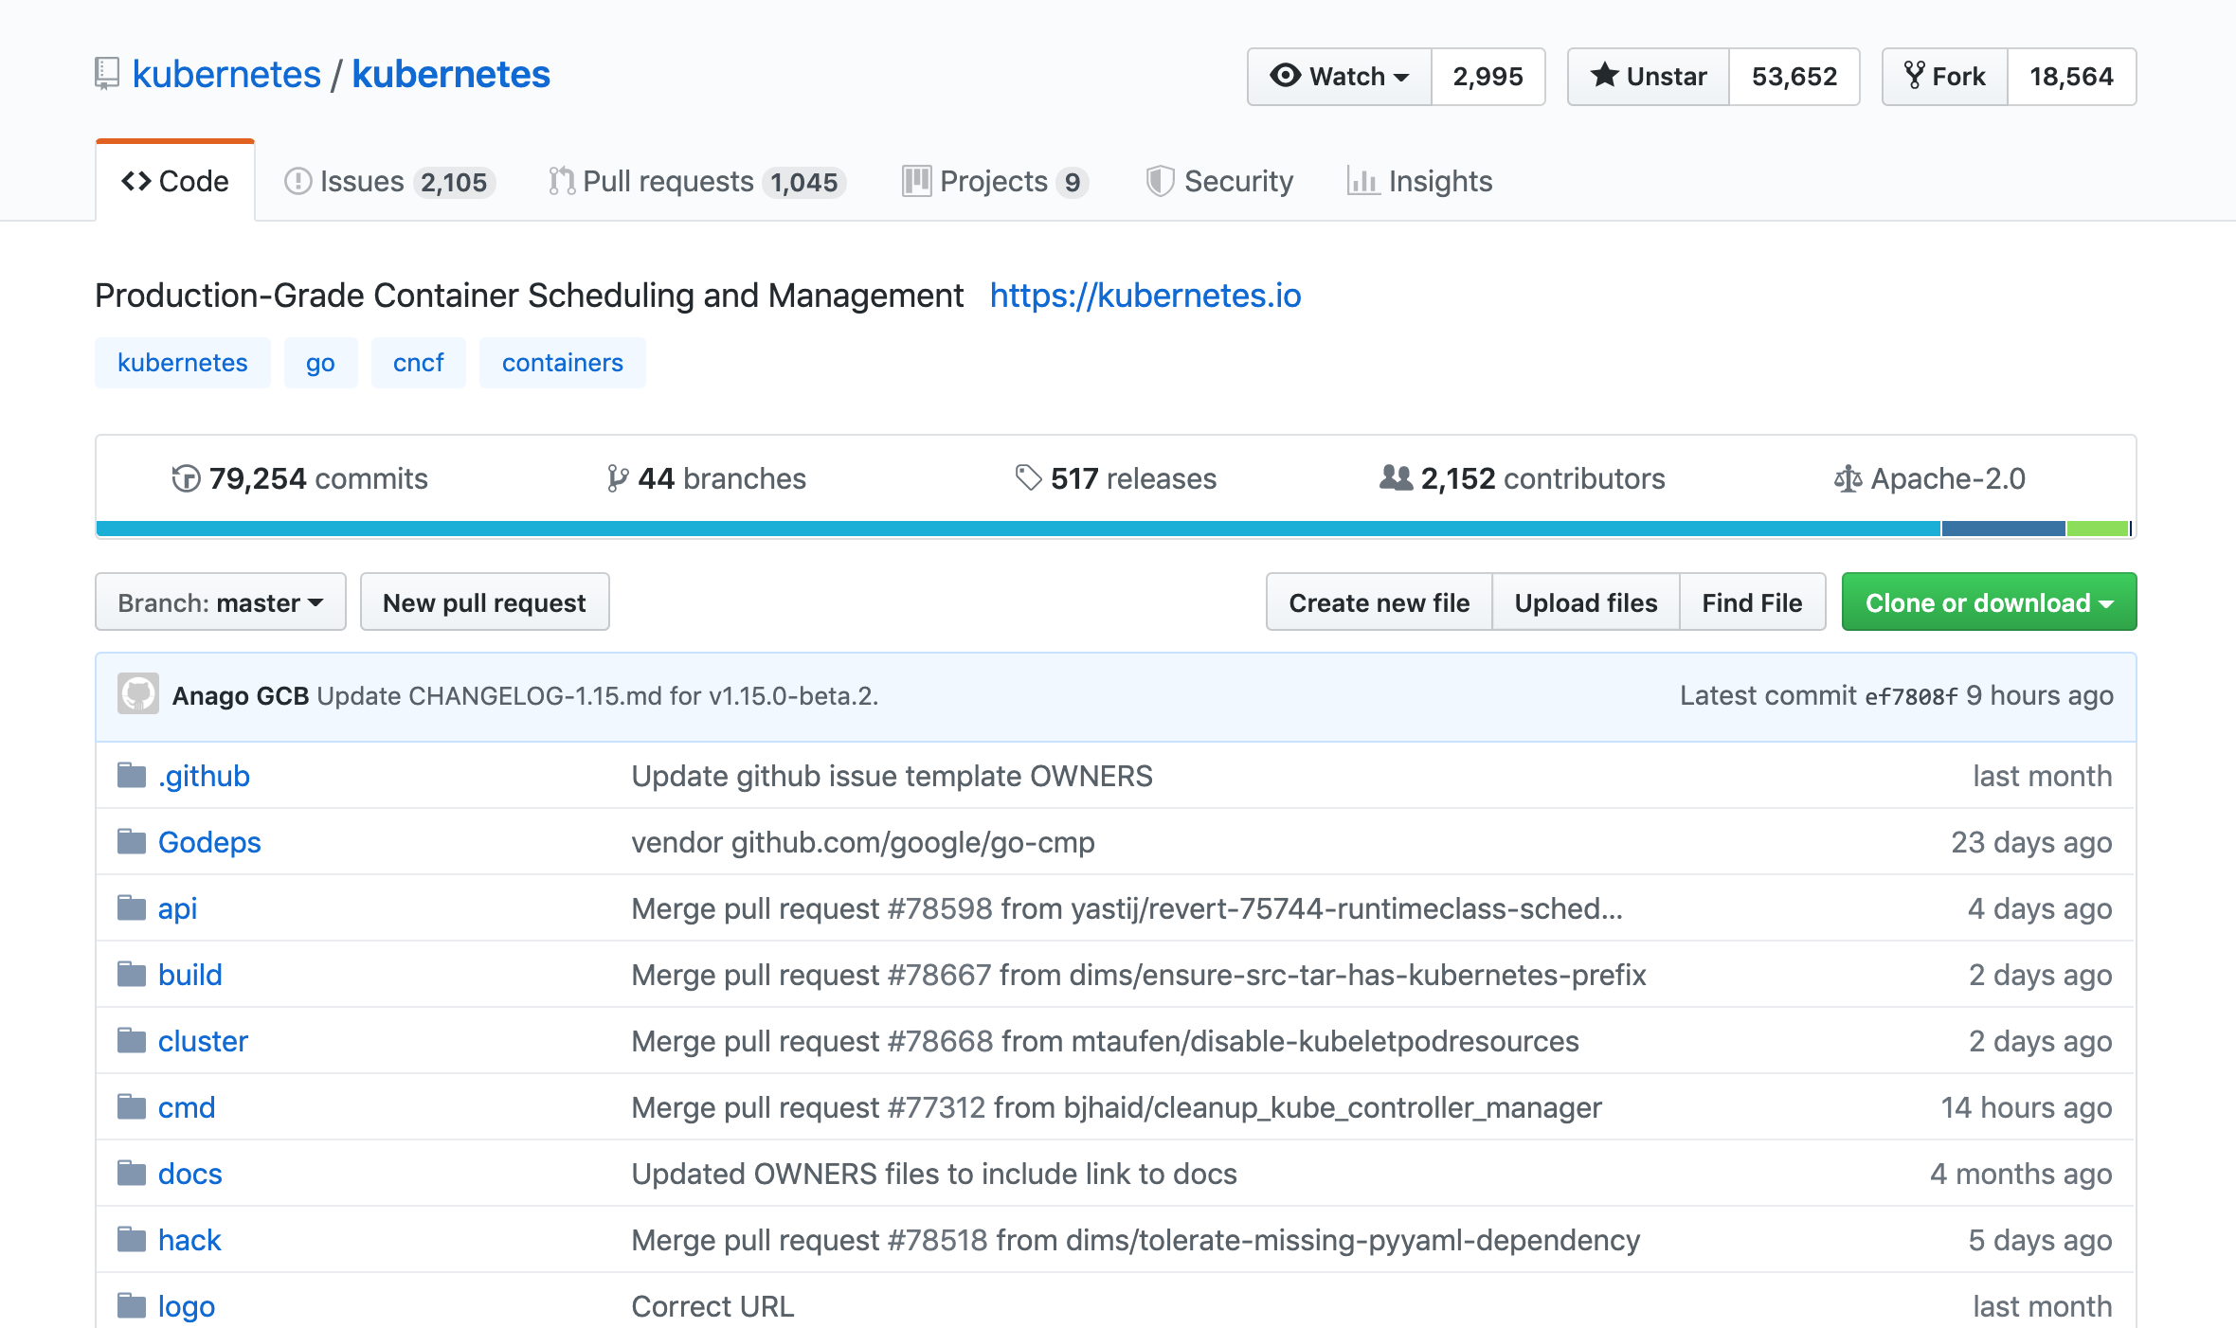

Slide 5
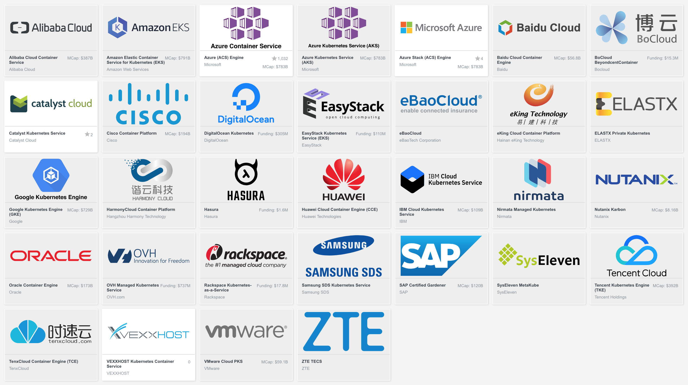

Slide 6
Agenda
1) Kubernetes dans le contexte des microservices
2) Création des images docker pour Linux
3) Enregistrement des conteneurs sur Docker Hub
4) Docker-compose pour le multi services
5) Déploiement avec les fichiers manifest en YAML
Déploiement sur Minikube
Déploiement sur un cluster Kubernetes sur Azure (AKS)
6) Création des pipelines CI/CD avec Azure DevOps

Slide 7
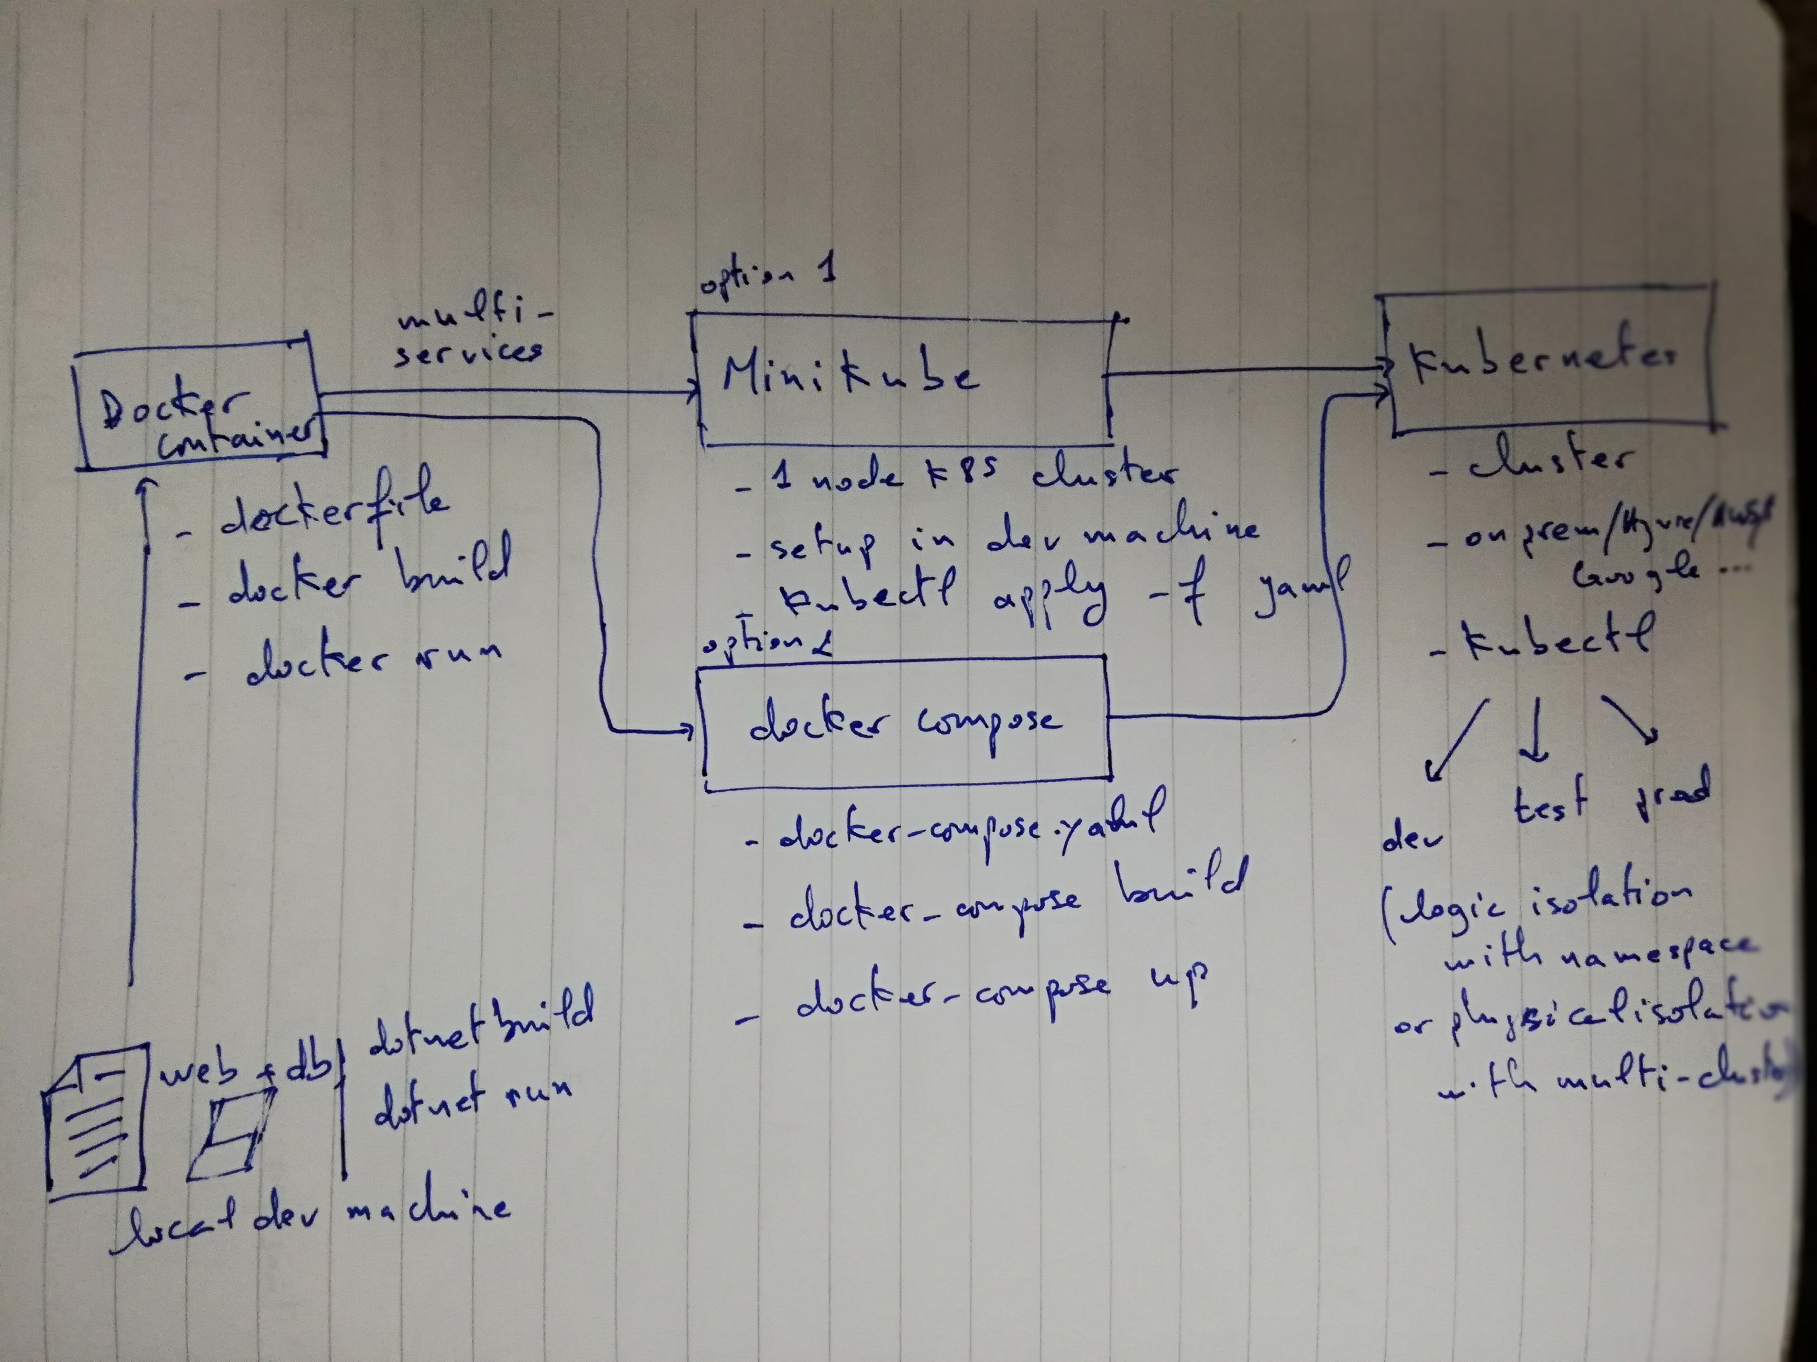

Slide 8
Architecture
Overview
Notes:
Get right into the meat of it

Slide 9
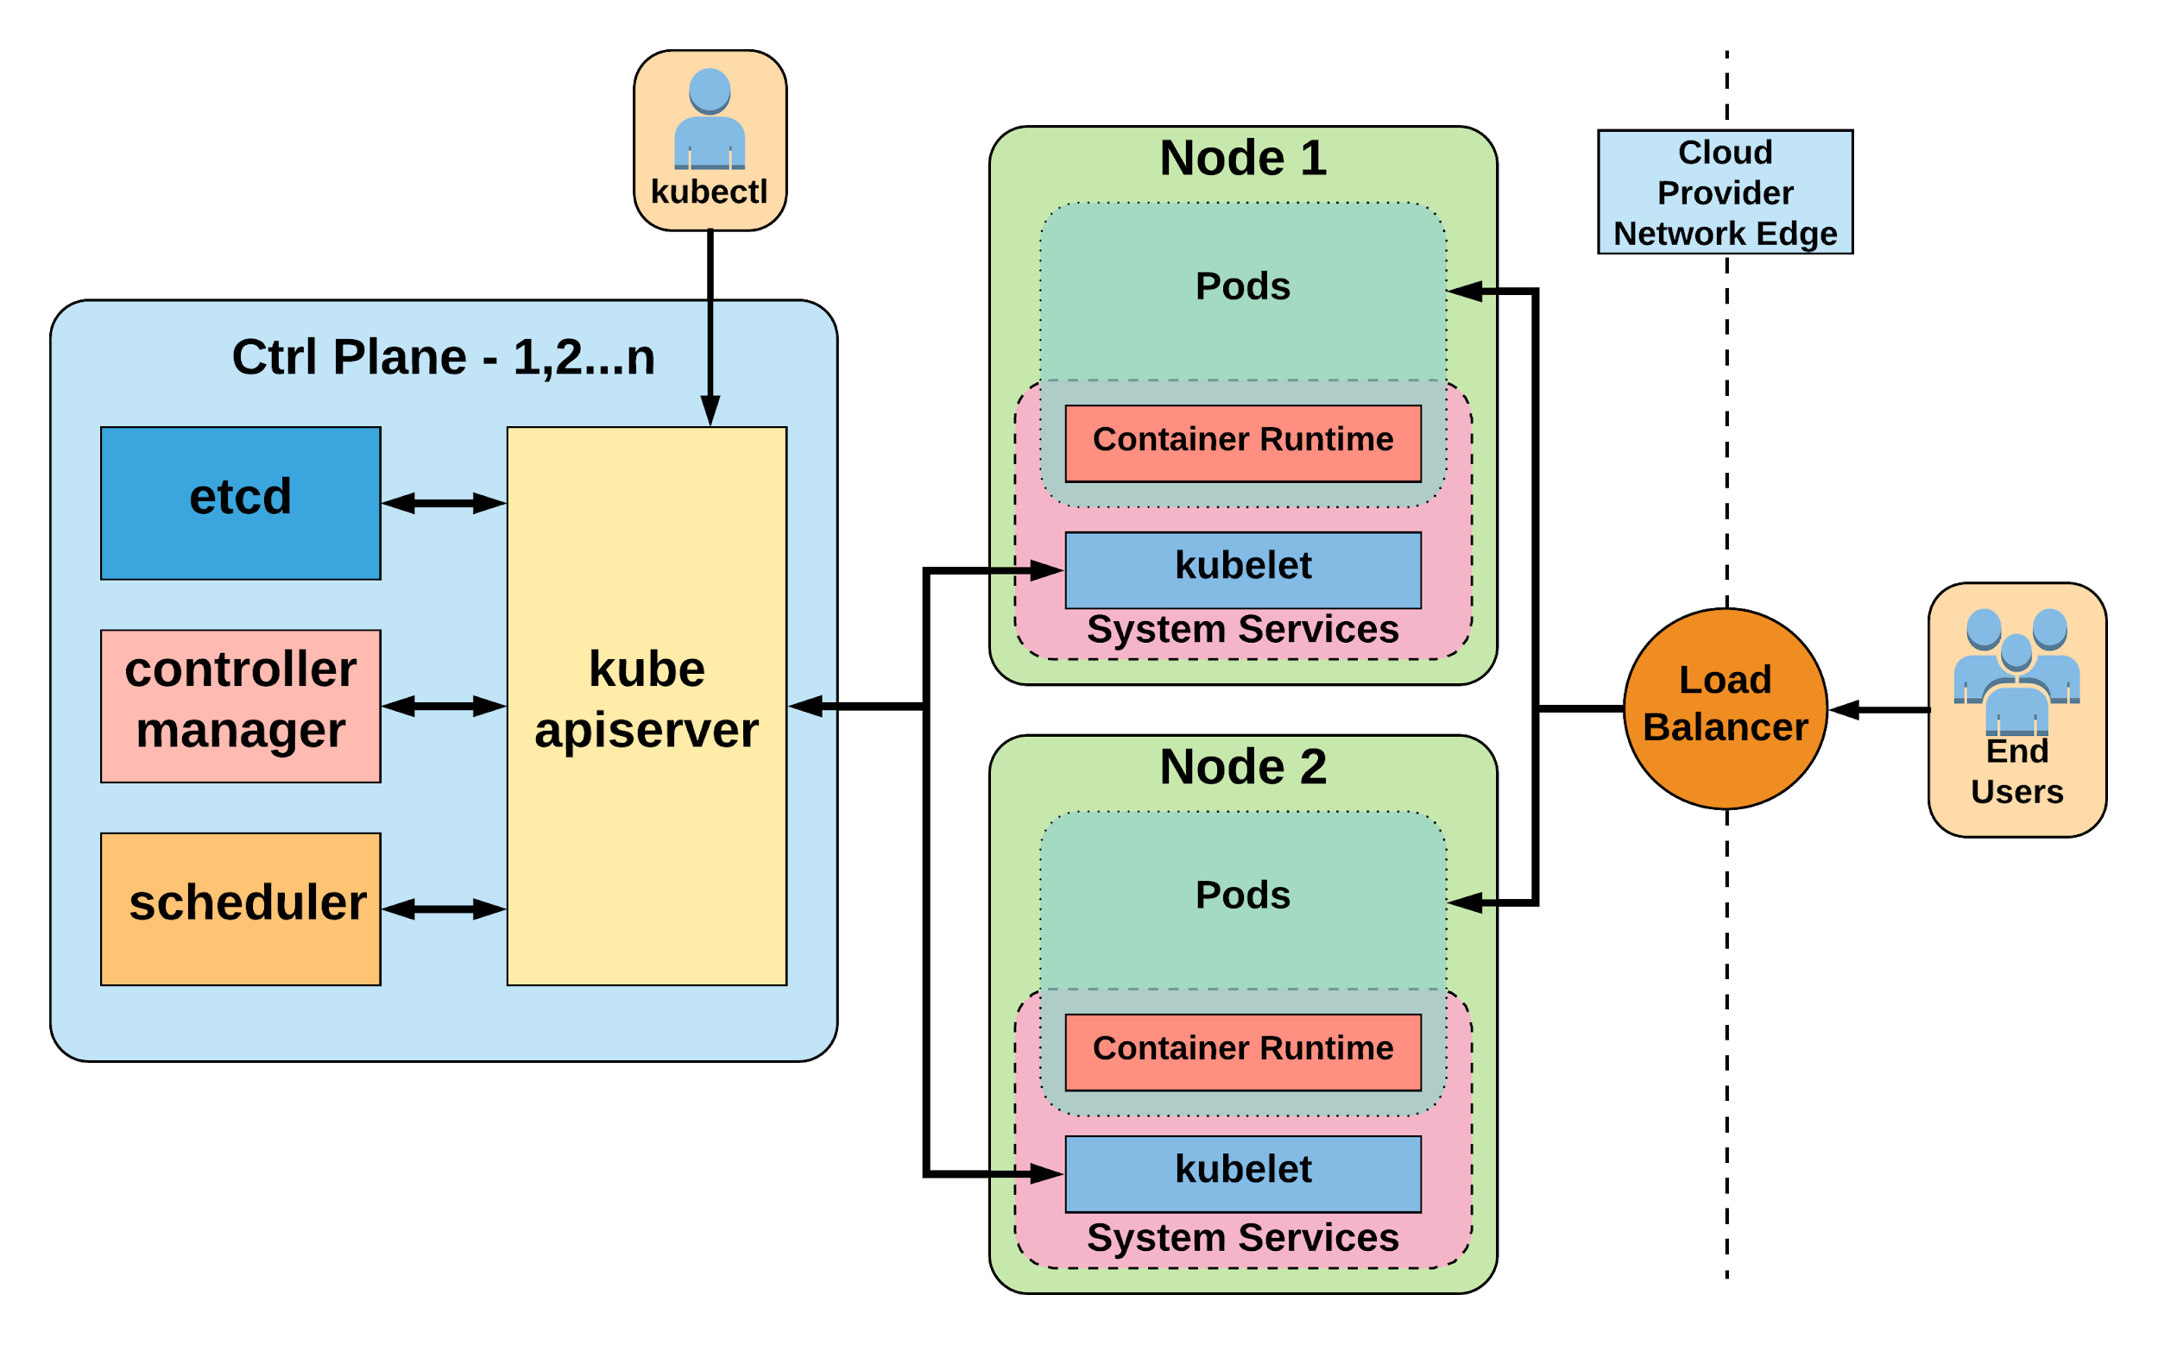
Notes:
General High Level Architecture Overview
There is 1-n number of masters or control plane servers, usually deployed in 1,3,5,7 configurations
Up to 5000 “worker nodes”

Slide 10
Create Kubernetes cluster
Azure Portal
Azure CLI
Azure ARM template
Terraform

Slide 11
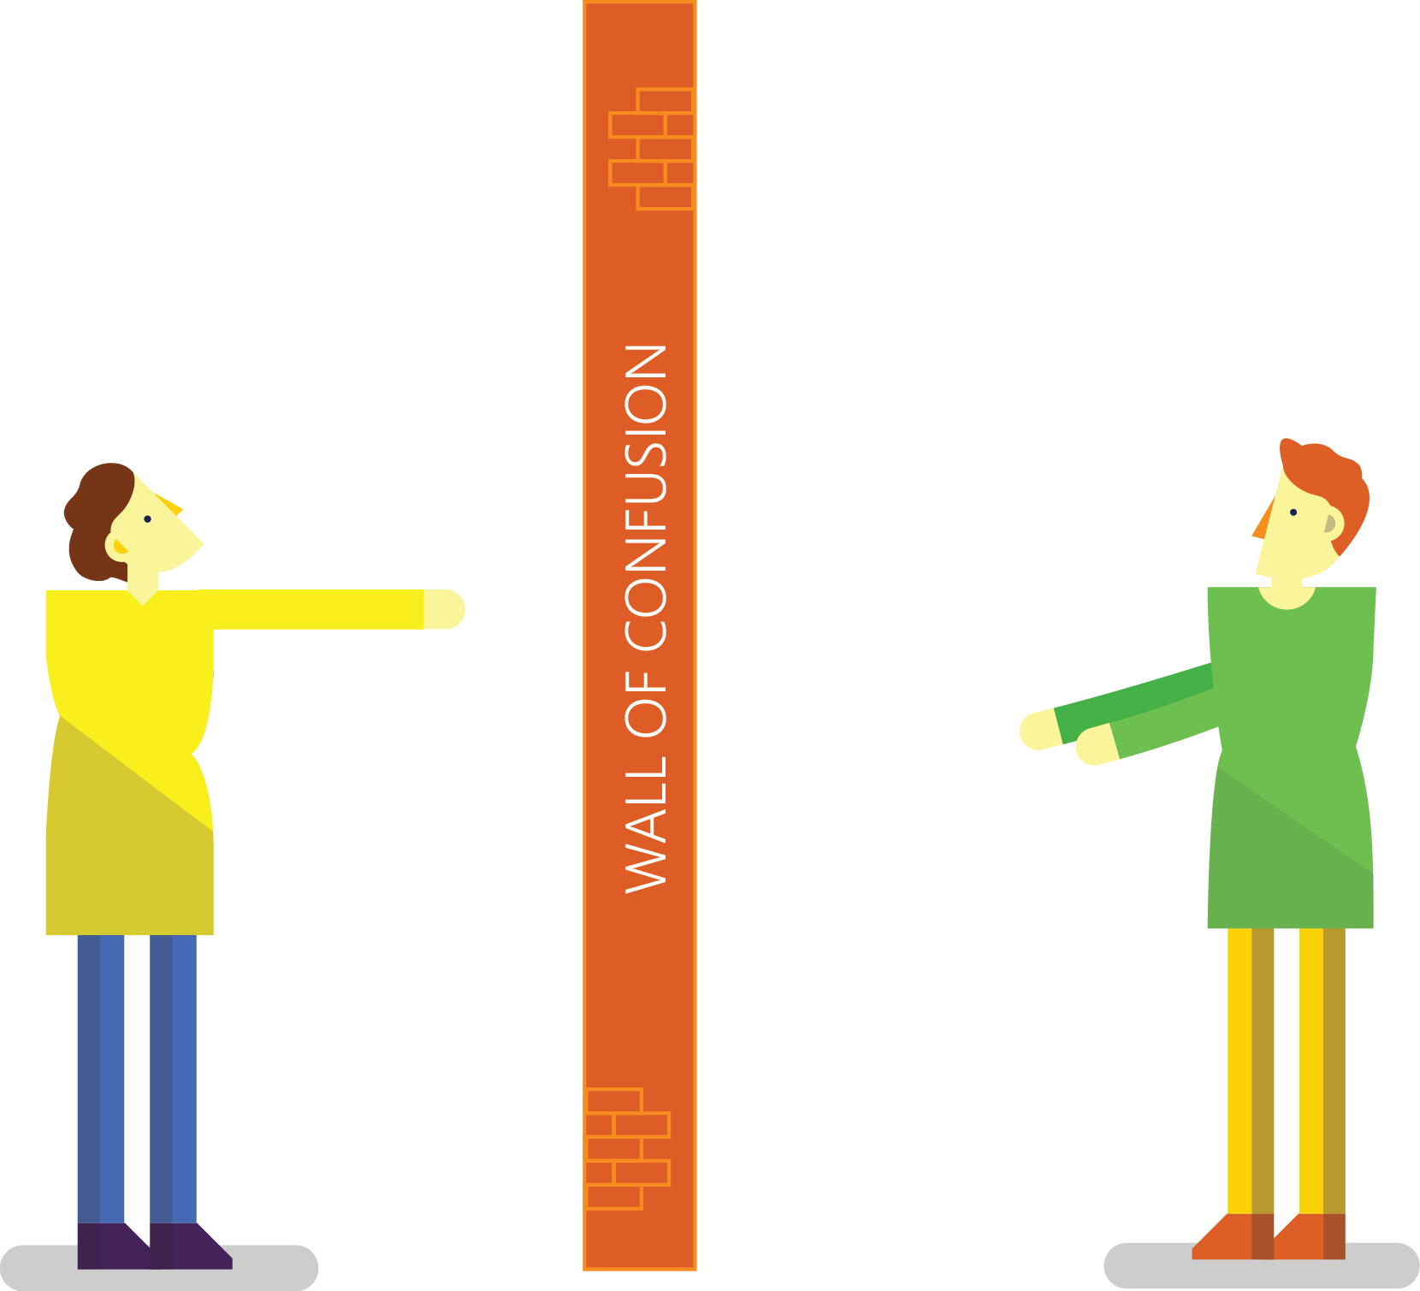

Traditional Development and Operations
DEV
OPS
Notes:
Taken from: http://dev2ops.org/2010/02/what-is-devops/
Development kicks things off by “tossing” a software release “over the wall” to Operations. Operations picks up the release artifacts and begins preparing for their deployment. Operations manually hacks the deployment scripts provided by the developers or creates their own scripts. They also hand edit configuration files to reflect the production environment, which is significantly different than the Development or QA environments. At best they are duplicating work that was already done in previous environments, at worst they are about to introduce or uncover new bugs.
Operations then embarks on what they understand to be the currently correct deployment process, which at this point is essentially being performed for the first time due to the script, configuration, process, and environment differences between Development and Operations. Of course, somewhere along the way a problem occurs and the developers are called in to help troubleshoot. Operations claims that Development gave them faulty artifacts. Developers respond by pointing out that it worked just fine in their environments, so it must be the case that Operations did something wrong. Developers are having a difficult time even diagnosing the problem because the configuration, file locations, and procedure used to get into this state is different then what they expect (if security policies even allow them to access the production servers!).
Time is running out on the change window and, of course, there isn’t a reliable way to roll the environment back to a previously known good state. So what should have been an eventless deployment ended up being an all-hands-on-deck fire drill where a lot of trial and error finally hacked the production environment into a usable state.

Slide 13



Resolving issues without DevOps
There is no problem with my code, you’re either deploying wrong or there is a problem with your infrastructure.
Infrastructure looks good, must be a code problem.
DEV
Customer finds problem with your application.
Operations gets notified of application problem.
OPS
Notes:
Pager image: http://www.medicoland.eu/ru/pager&page=4

Slide 14

Conflicts across Dev, Ops, and Business
Ops: “You’re losing us money with all these outages!”
Dev: “I need 5 more features on the application by next week.”
You’re causing me outages with all your frequent updates to production… behind my back!
I’m just trying to crank out the code quickly to keep the boss happy. You’re only slowing me down!
BUSINESS
DEV
OPS
Notes:
Dev: “What’s the point of an Agile development process, that produces production ready code every two weeks, if the code sits for weeks or months waiting to be released?”
IT/Ops: “These frequent releases are killing my team, and impacting our ability to have a stable environment!”

Slide 15

“DevOps is development and operations collaboration”
“DevOps is treating your infrastructure as code”
It’s DevOps!
It’s DevOps!
“DevOps is using automation”
It’s DevOps!
“DevOps is feature switches”
It’s DevOps!
“DevOps is small deployments”
“Kanban for Ops?”

Slide 16

DevOps Basics
4) Continuous Deployment
2) Code Repository
3) Continuous Integration & Test
5) Monitoring and Improvement
1) Dev & Ops

Slide 17
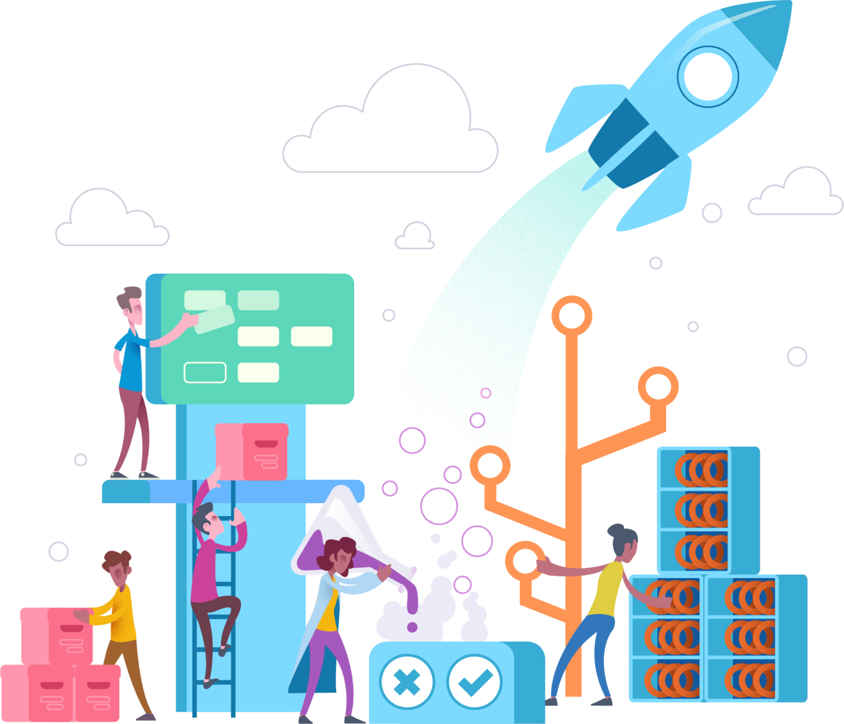
Azure DevOps

Slide 18





Introducing Azure DevOps
Azure Boards
Azure Pipelines
Azure Repos
Deliver value to your users faster using proven agile tools to plan, track, and discuss work across your teams.
Build, test, and deploy with CI/CD that works with any language, platform, and cloud. Connect to GitHub or any other Git provider and deploy continuously.
Get unlimited, cloud-hosted private Git repos and collaborate to build better code with pull requests and advanced file management.
Azure Test Plans
Azure Artifacts
➔
Test and ship with confidence using manual and exploratory testing tools.
Create, host, and share packages with your team, and add artifacts to your CI/CD pipelines with a single click.
https://azure.com/devops
Notes:
So does TFS

Slide 19
